Slide 1

Resume Classification
Team 6

Slide 2
Team members
Mr. Sanjai Kumar R
Mr. Hrushikesh M Doke
Mr. Sharath S
Mr. Ashishkumar Chaurasiya
Mr. Fida E V
Mr. Sabina Pinjar

Slide 3
Business Objective
The document classification solution should significantly reduce the manual human effort in the HRM .It should achieve a higher level of accuracy and automation with minimal human intervention.

Slide 4
Overview of project
The NLP-based resume classification project aims to streamline HRM processes by automating the categorization of resumes.
Leveraging advanced natural language processing techniques, the solution will accurately identify and classify resumes into relevant categories such as job roles or skillsets. By reducing manual effort, the project seeks to enhance efficiency and productivity within the HR department.
The system will continuously learn and adapt to improve classification accuracy over time, minimizing the need for human intervention.
Through this automation, HR professionals can focus on strategic tasks rather than repetitive administrative duties.

Slide 5
Project Architecture
Collection Of Data
Business Understanding
EDA
Deployment
Model Building

Slide 6
Database description
Peoplesoft Resume
Workday Resume
Experience in PeopleSoft and Workday development, ReactJS proficiency, and SQL expertise showcased across HR, Finance, Supply Chain, HCM, Financial modules with proficiency in PeopleTools, SQR, PeopleCode, Workday Studio, EIB, Redux, TypeScript, SQL programming, database design, complex queries, stored procedures, triggers, performance tuning, and administration.
SQL Developer
Resume
React JS
Resume

Slide 7
Imported libraries
Libraries Used In Project:
import nltk
from sklearn.feature_extraction.text import TfidfVectorizer
from sklearn import svm, naive_bayes
import gensim
import spacy
import pandas as pd
import matplotlib.pyplot as plt
import seaborn as sns

Slide 8
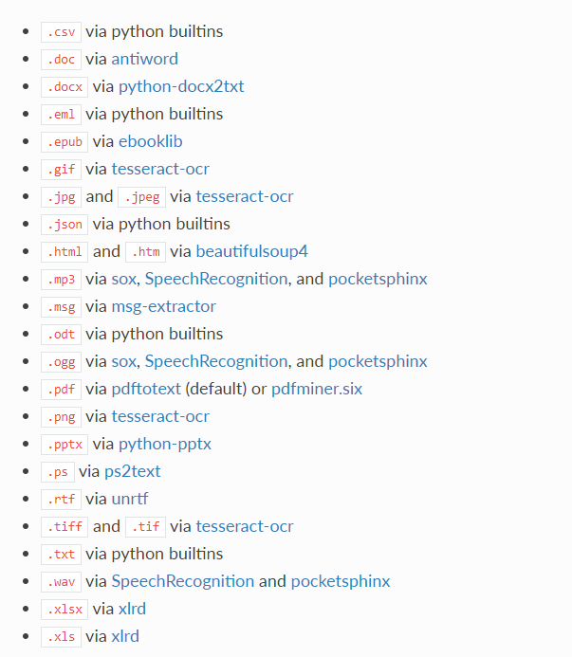
This package provides a single interface for extracting content from any type of file, without any irrelevant markup.
TEXTRACT

Slide 9
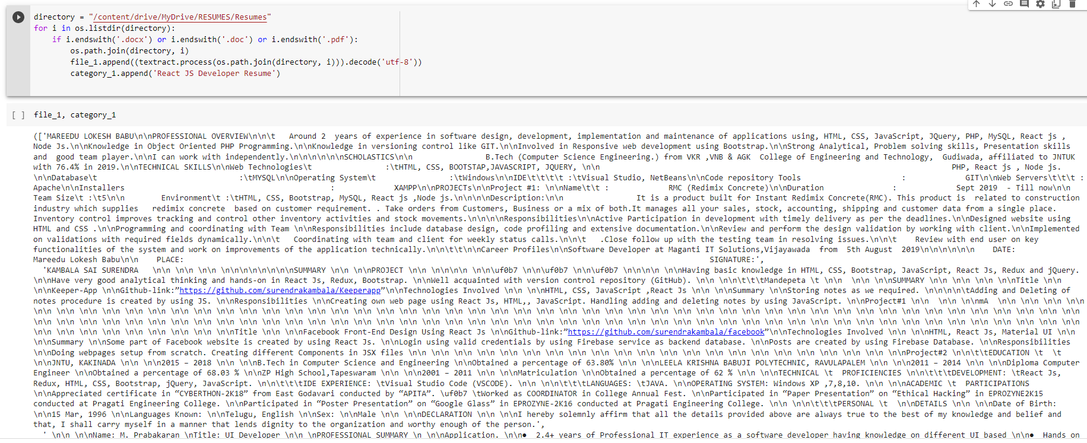
Data preprocessing

Slide 10
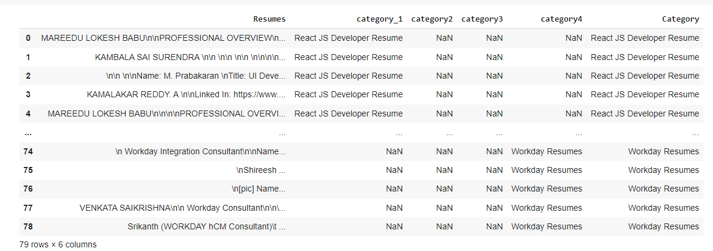
Merging all category files.

Slide 11
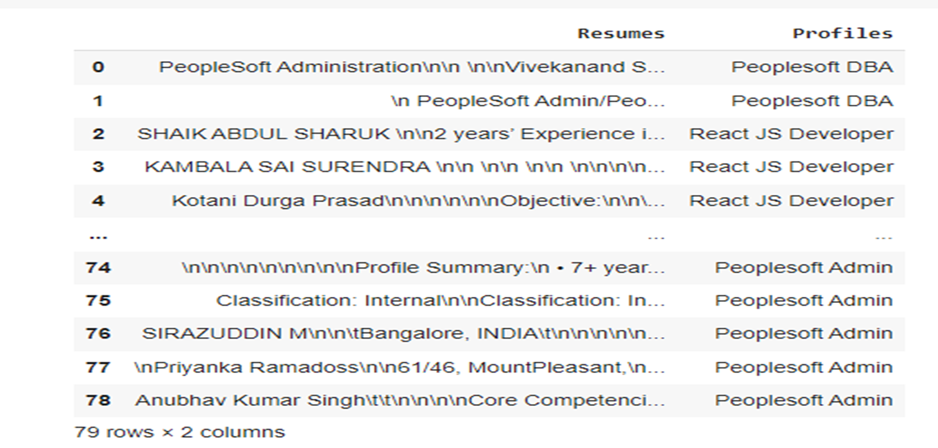
Converting text to .csv (Process)

Slide 12
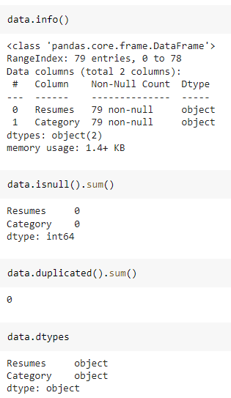
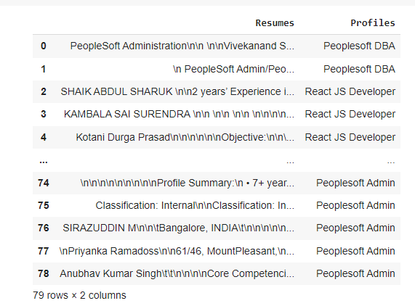
Data Set Details
After Extracting and Modifying the Dataset, given data contains a total of 4 Classes and 79 rows .

Slide 13
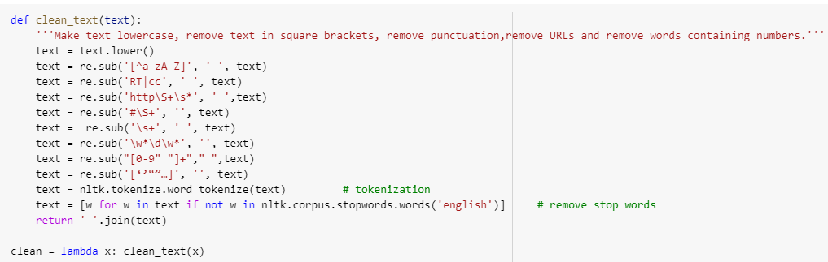
Removing All Unwanted Character’s
Unwanted Character’s like - \n \t, http links, tags, hashtags, html tags, converting to lower case, removing white spaces etc.
Word Tokenization - Tokenization is essentially splitting a phrase, sentence, paragraph, or an entire text document into smaller units, such as individual words or terms. Each of these smaller units are called tokens.
Removing Stop-words - A stop word is a commonly used word (such as “the”, “a”, “an”, “in”) that a search engine has been programmed to ignore, both when indexing entries for searching and when retrieving them as the result of a search query.

Slide 14
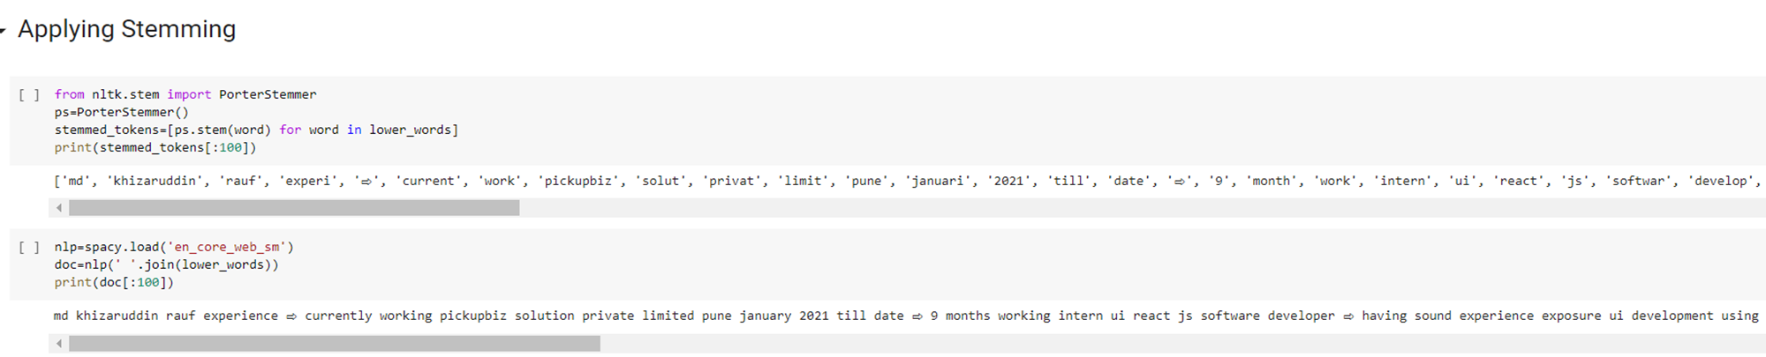
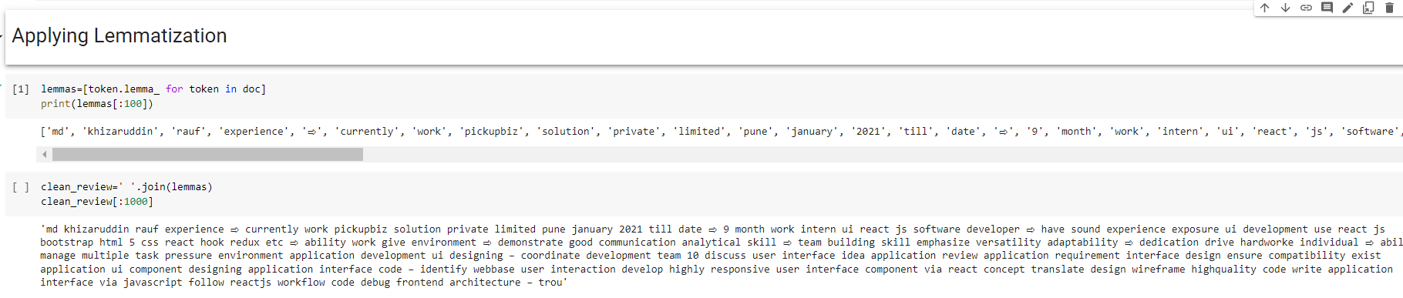
Text – Preprocessing
The Porter stemming algorithm (or 'Porter stemmer') is a process for removing the commoner morphological and inflectional endings from words in English.

Slide 15
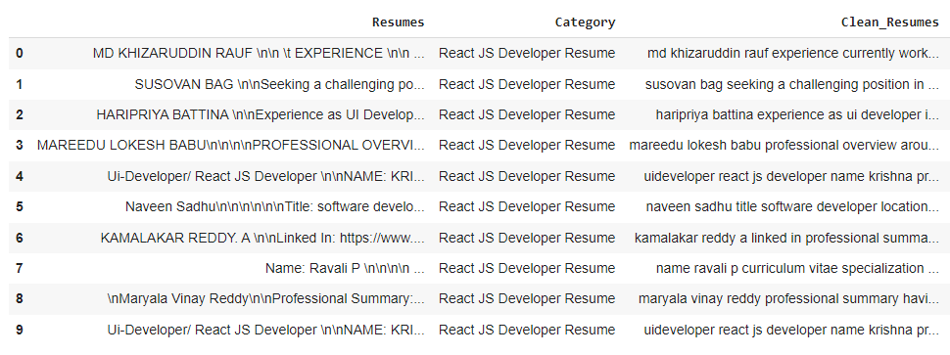
Text – Preprocessing
Before Text – Preprocessing After Text – Preprocessing
The Dataset contains 79 rows and 3 Column
There are total four Classes – Peoplesoft, Workday, React JS Developer and SQL Developer.

Slide 16
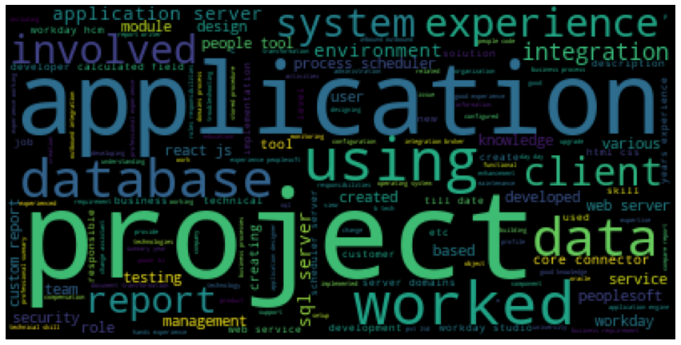

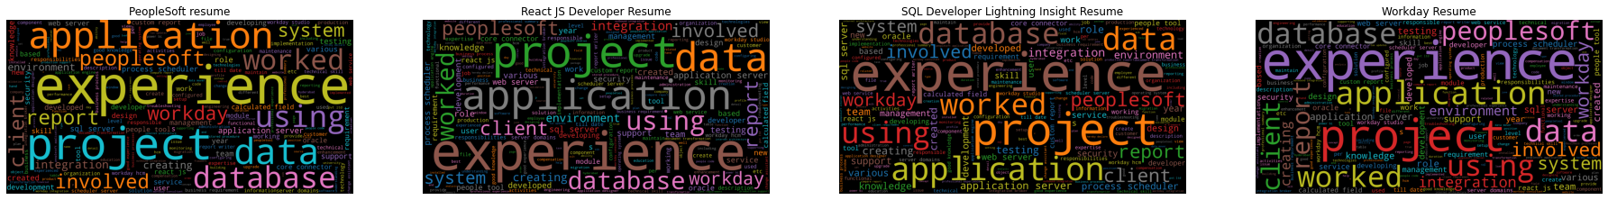
Word cloud

Slide 17
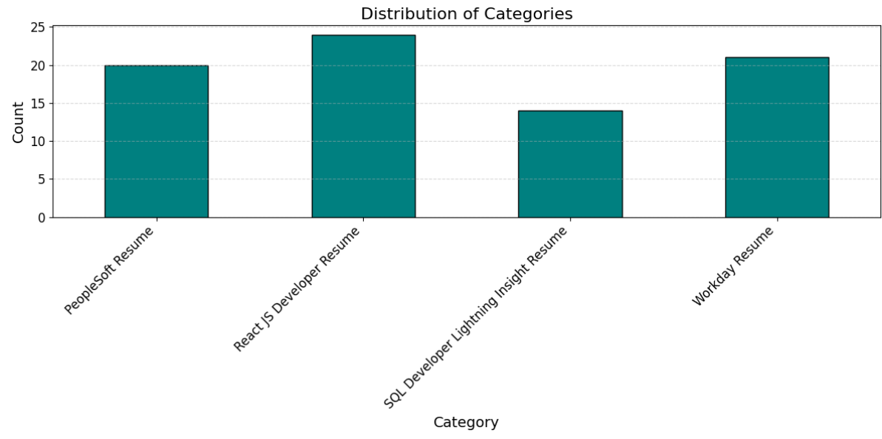
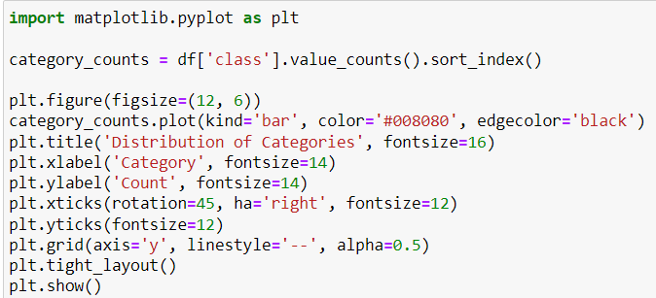
Category wise resume distribution

Slide 18
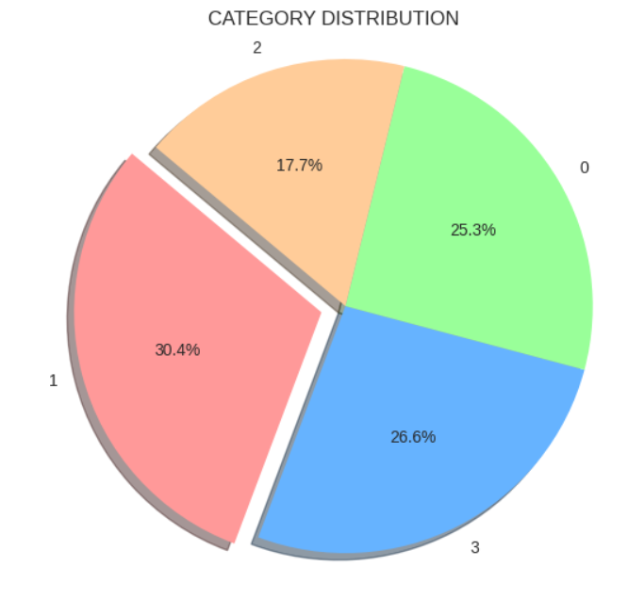
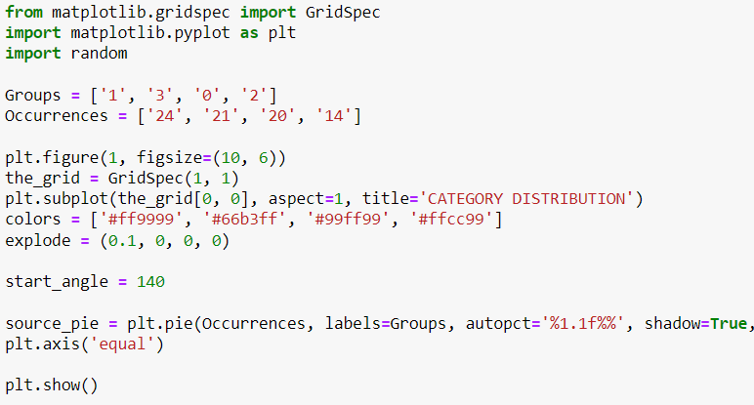
Category wise distribution in percentage

Slide 19
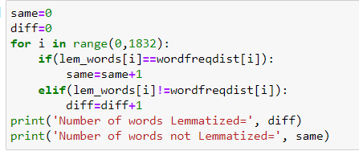
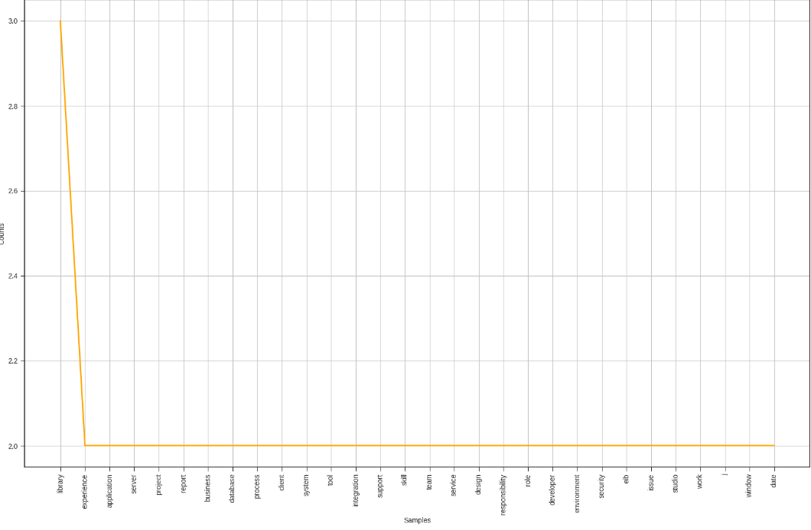

Resume words checking length

Slide 20
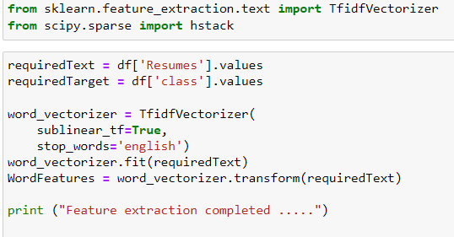
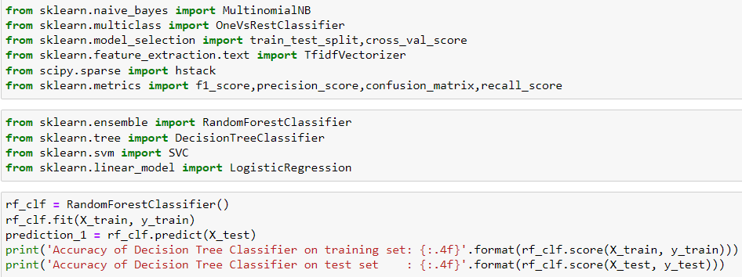
Model Building we tried out various type of classifier models

Slide 21
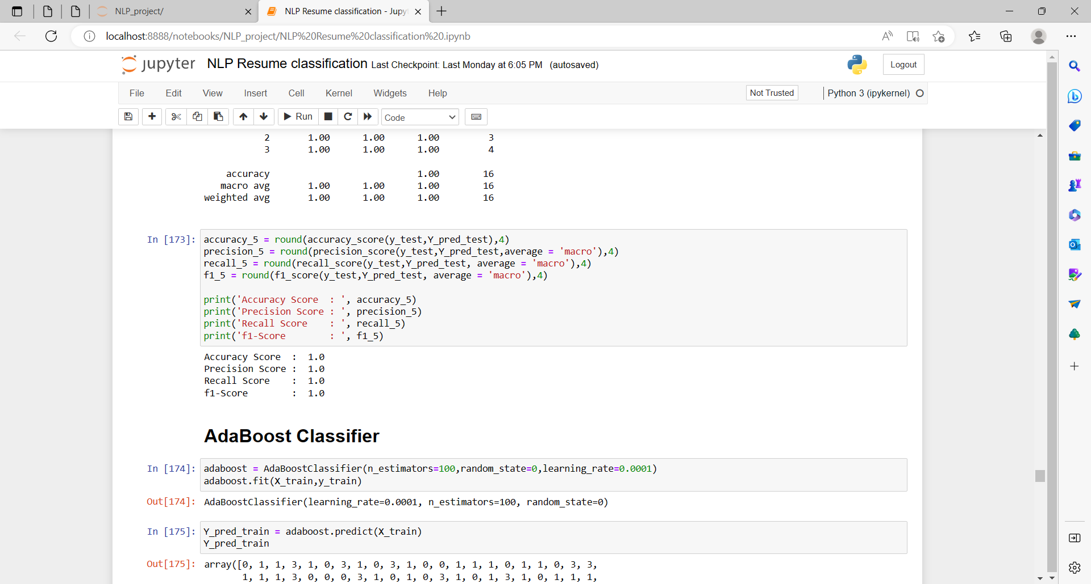
Among all those models random forest model gives more accuracy

Slide 22
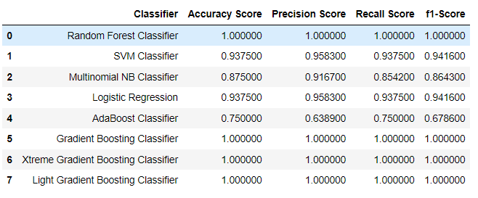
Best recommendation models

Slide 23
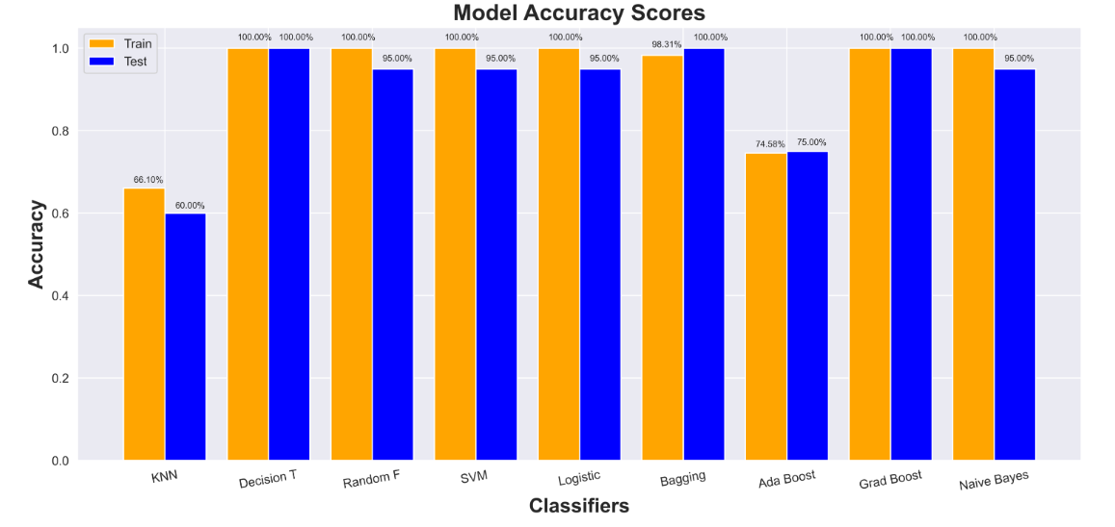
Model accuracy scores

Slide 24
Conclusion
The Resume Classification Project aims to revolutionize HRM operations by leveraging automation and machine learning. Through this initiative, we seek to achieve higher efficiency and accuracy in document classification, ultimately driving organizational success. After careful evaluation, it has been determined that the Random Forest model stands out with an impressive accuracy rate of 100 percent. Therefore, we have chosen the Random Forest model as the optimal solution for our project, confident that it will effectively streamline HRM processes and contribute to our overarching objectives. Together, let's embrace this innovative approach to enhance HRM operations and propel our organization towards greater success.

Slide 25
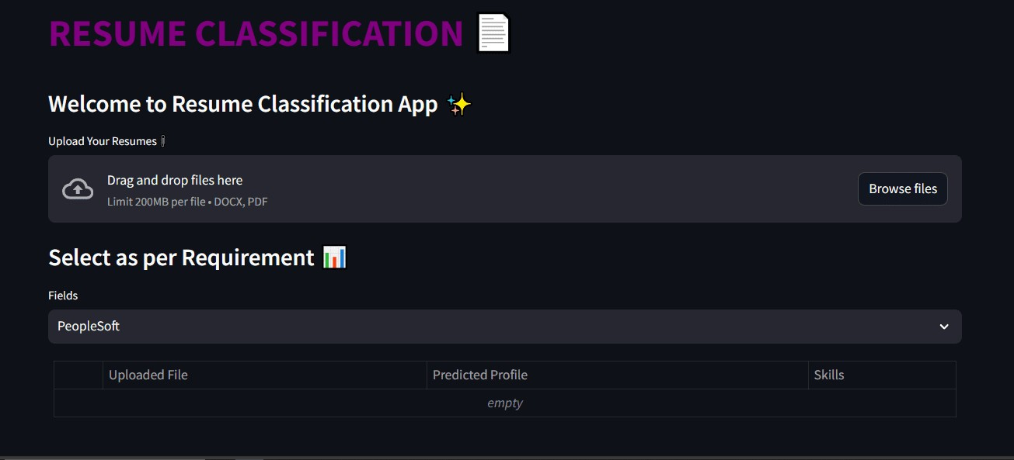
Deployment

Slide 26
Thank
You

